Slide 1
Women & Minority Business Enterprises (WMBE) Dashboard
Carmen Lu

Slide 2
Goals
To monitor our spend and vendor participation with Women & Minority Business Enterprises (WMBE)
To give us a clear picture of current performance, historical trends, and areas where we can improve for WMBE program.

Slide 3
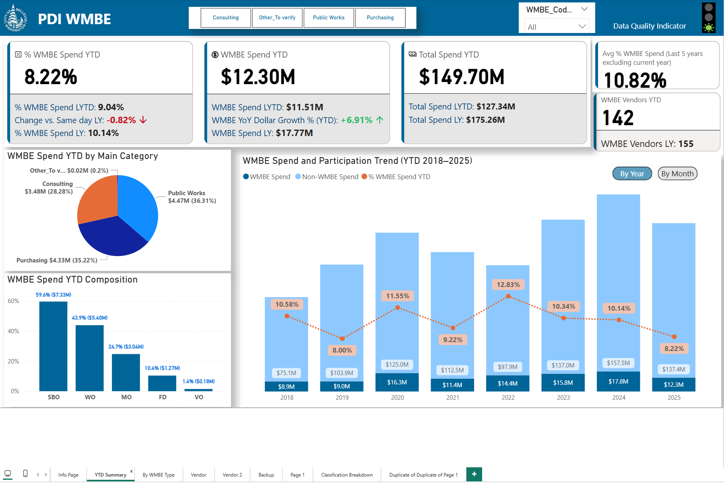
Content
1. YTD Summary
A quick overview of the WMBE Year-To-Date progress
2. By WMBE Type
How each WMBE classification and three main purchasing categories are performing:
WMBE Classification:
FD - Federally Disadvantage /
MO - Minority Owned /
SBO - Small Business Owned /
VO - Veteran Owned /
WO - Woman Owned
Main Purchasing Categories:
Purchasing
Public Works
Consulting
3. Vendor Analysis
Help us to understand our WMBE vendor participation.
Notes:
Currently, PowerBi can’t auto refresh is using Python script, so I chose SQL query to make sure data auto refesh. Data Lakehouse is coming, but we can make some changes with that.

Slide 4
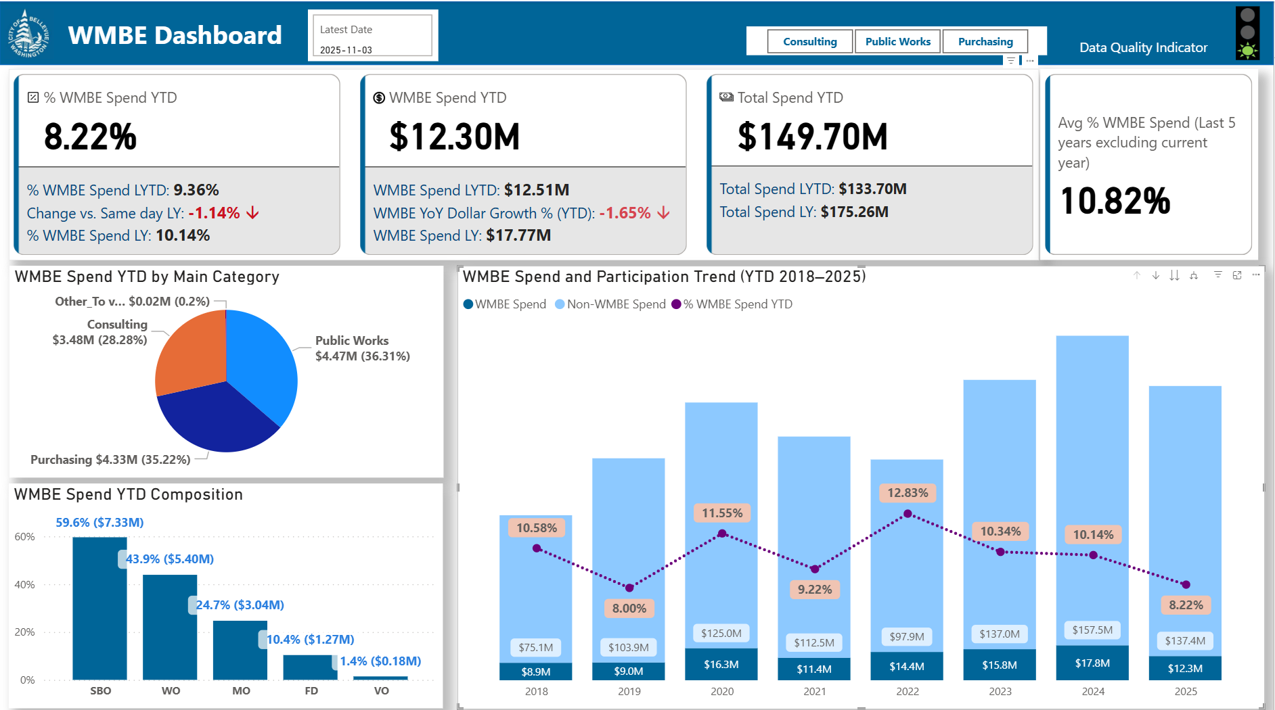
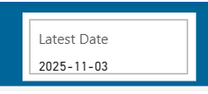
Year-to-date Summary
This YTD Summary page is focusing to track our WMBE YTD progress.
Latest Transaction Date
Data extraction directly from database, and can be set to auto-refresh on a schedule.
YTD metrics are calculated through the latest available transaction date.

Slide 5
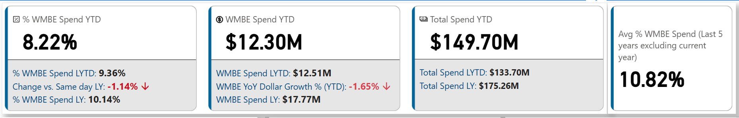
Key Metrics: Year-to-date summary
% WMBE Spend (YTD)
What percentage of total spending has gone to WMBE vendors year-to-date.
Compared against same day last year's performance and Last Year %.
Total Procurement Spend (YTD)
Compared against Last Year YTD, and Last Year.
WMBE Spend (YTD)
Dollar amounts spent with WMBE vendors YTD.
Comparison includes Last Year YTD, Dollar Growth % vs. Last Year YTD, Last Year spend.
Average Percentage WMBE Spend
Counting last 5 years’ number excluding current year

Slide 6
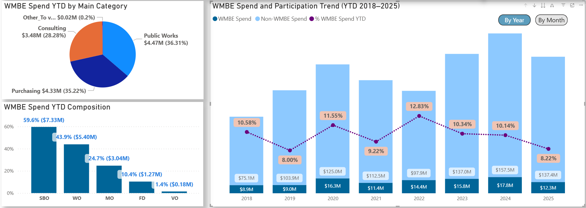
Key Metrics: Year-to-date summary
WMBE Spend YTD by Main Purchasing Category
Break out WMBE spend across Purchasing, Public Works, and Consulting.
WMBE Spend & Participation Trend
WMBE vs. Non-WMBE spend amount over the year comparison, WMBE % historical performance.
Can drill into year or month.
WMBE Spend Composition YTD
Which WMBE type contribute most to WMBE participation?
Note: Each vendor can be multiple WMBE types, so totals exceed 100%.
Notes:
Currently, PowerBi can’t auto refresh is using Python script, so I chose SQL query to make sure data auto refesh. Data Lakehouse is coming, but we can make some changes with that.

Slide 7

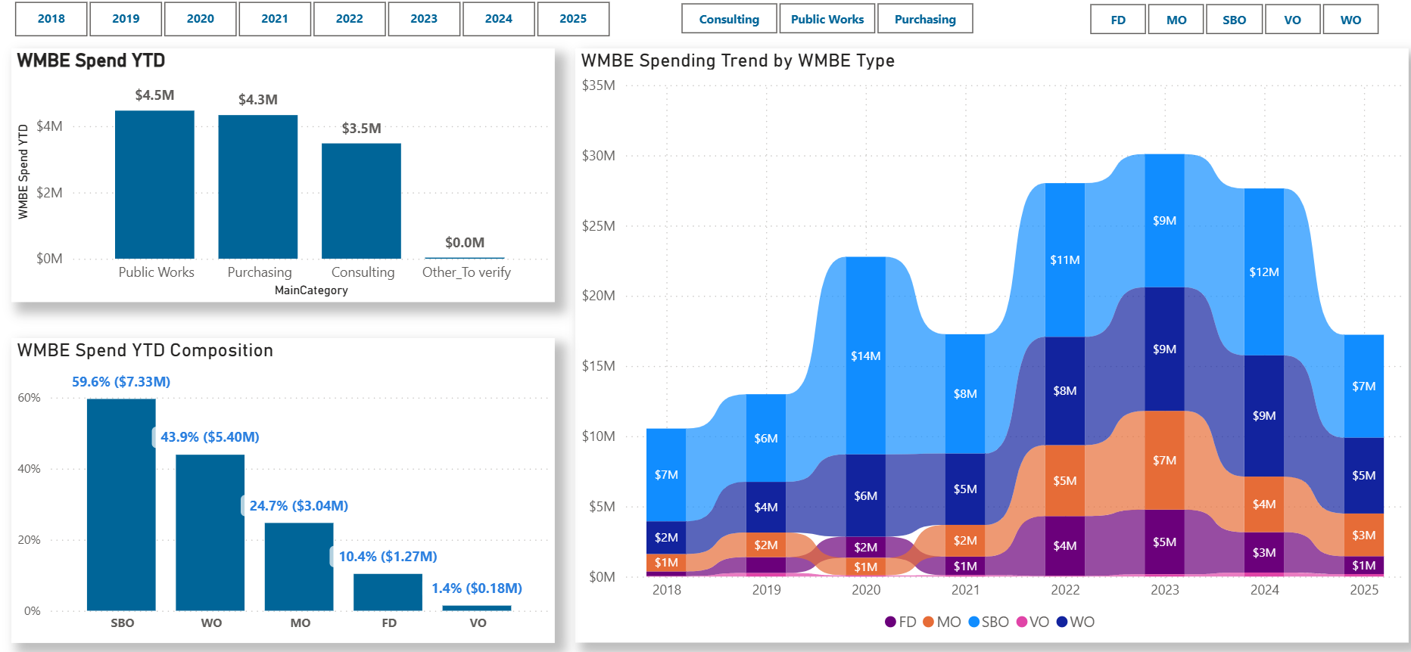
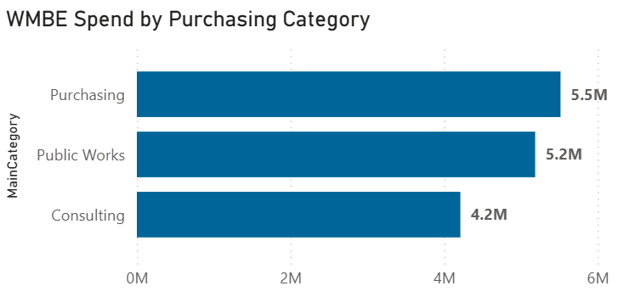
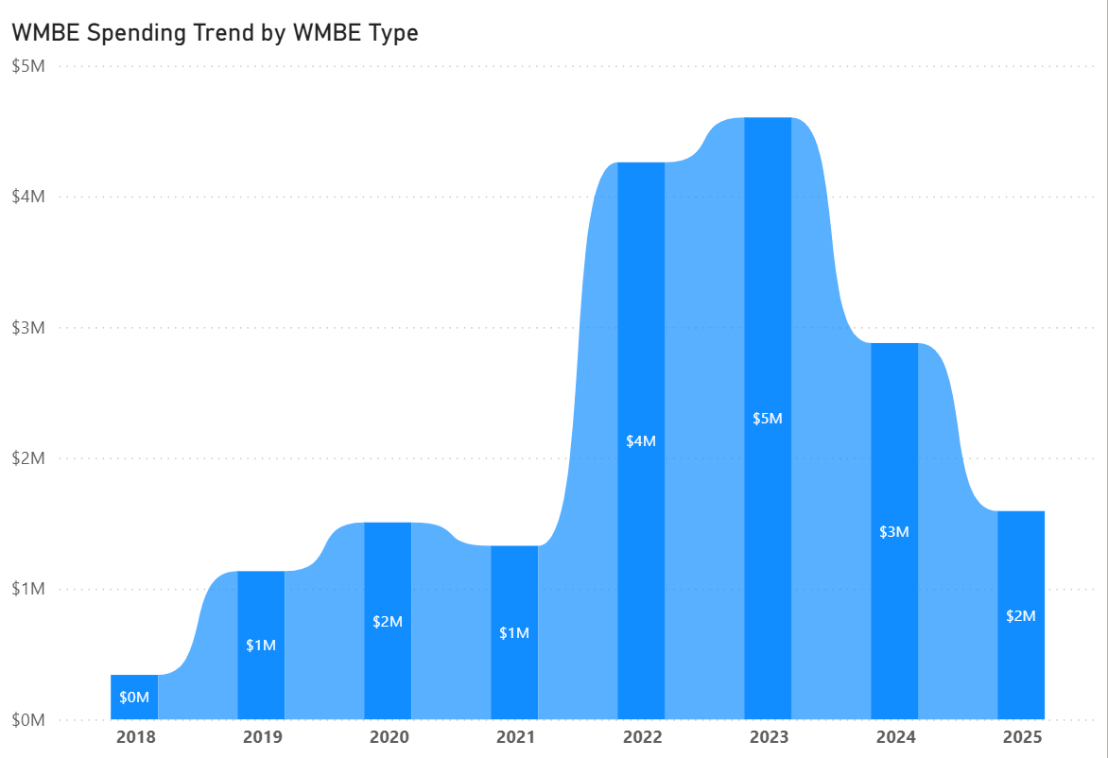

Key Metrics: By WMBE Type
Three interactive filters
by year, main purchasing category, WMBE type
WMBE Spend Breakdown by Main Purchasing Category
Segments WMBE spend by main procurement categories: Purchasing, Consulting, Public Works, and Other, showing which business areas are most engaged with diverse vendors.
WMBE Spend Composition by WMBE Type
Breaks down spend across the five types of WMBEs (FD, MO, SBO, VO, WO) to identify inclusion patterns.
WMBE Spending Historical Trend by WMBE Type
Historical trend visuals showing how the WMBE spending changes across those five types of WMBEs (FD, MO, SBO, VO, WO)
Notes:
Currently, PowerBi can’t auto refresh is using Python script, so I chose SQL query to make sure data auto refesh. Data Lakehouse is coming, but we can make some changes with that.

Slide 8
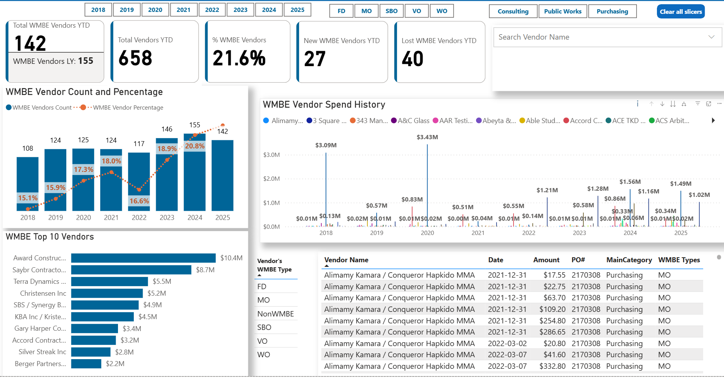
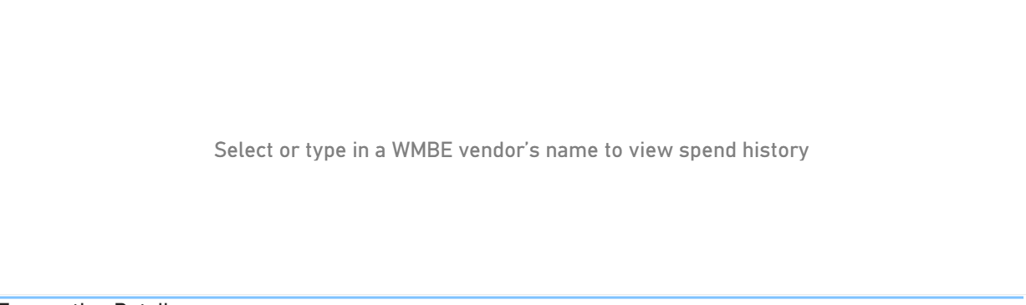
Key Metrics: Vendor Analysis
Notes:
Currently, PowerBi can’t auto refresh is using Python script, so I chose SQL query to make sure data auto refesh. Data Lakehouse is coming, but we can make some changes with that.

Slide 9
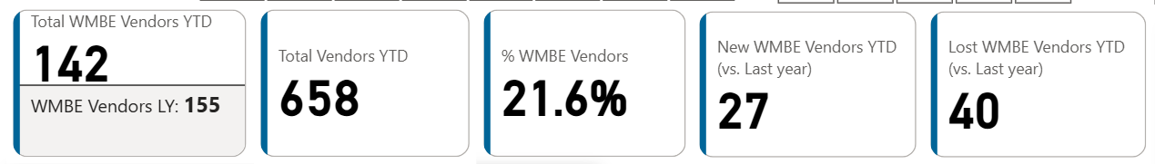
Key Metrics: Vendor Analysis
Total WMBE Vendor YTD
Shows how many WMBE vendors we've engaged this year so far
compared against last year
Percentage of WMBE Vendors
Showing % of Vendors that are WMBE
Total Vendors YTD
Based on all procurement data
New WMBE Vendors YTD (vs. Last year)
This shows the number of WMBE vendors that have done business with the City this year but had no business with us last year.
Measures how well the City is attracting new WMBE businesses
Lost WMBE Vendors YTD (vs. Last year)
WMBE vendors who did business with the City last year but have not done any business this year.
Indicates how many previously engaged WMBE vendors are dropping off. (Trigger us to follow up to see any barriers )
Notes:
Currently, PowerBi can’t auto refresh is using Python script, so I chose SQL query to make sure data auto refesh. Data Lakehouse is coming, but we can make some changes with that.

Slide 10
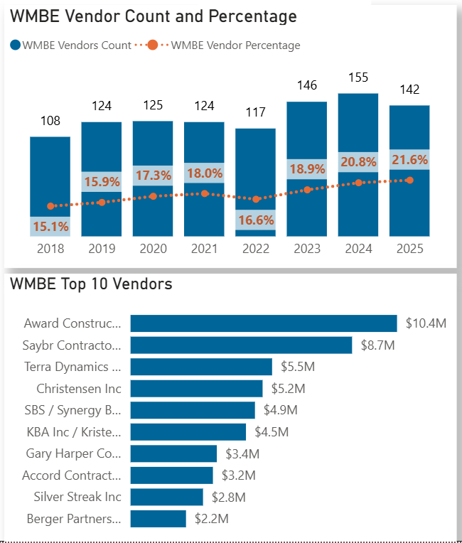
Key Metrics: Vendor Analysis
WMBE Vendor Count and Percentage
Year-over-year changes in both the count of WMBE vendors and their percentage of the total vendor base.
WMBE Top 10 Vendors
A ranked list to recognize high-impact WMBE Vendors by spend.
Notes:
Currently, PowerBi can’t auto refresh is using Python script, so I chose SQL query to make sure data auto refesh. Data Lakehouse is coming, but we can make some changes with that.

Slide 11
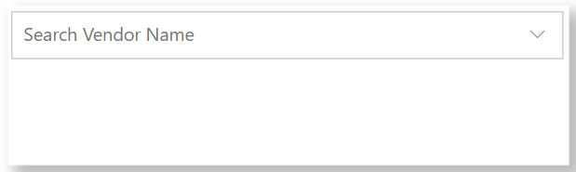

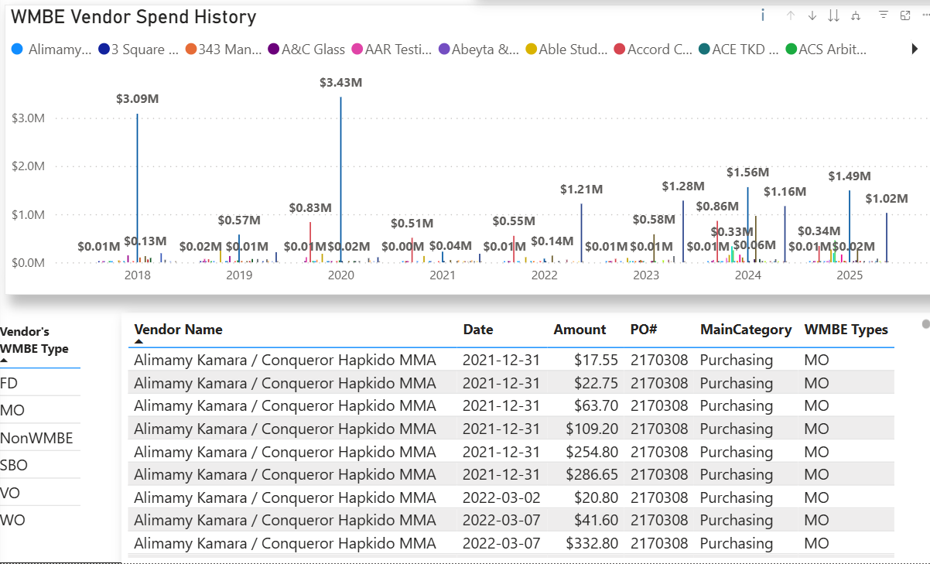
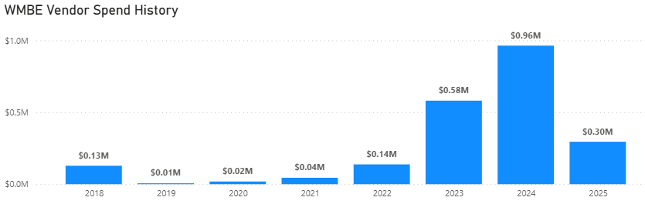
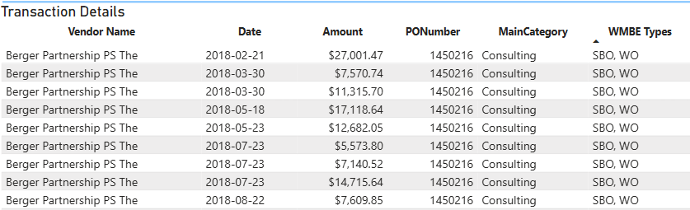
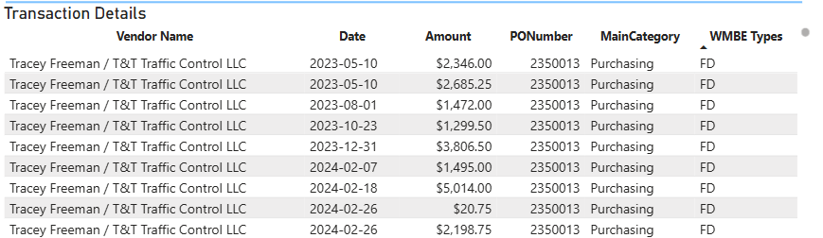
Key Metrics: Vendor Analysis
WMBE Vendor Spend History Visuals and Search bar
By searching vendor name, we can see vendor’s historical contract amount, and year-over-year trends in spending and participation.
Transaction Detail Table
An interactive table allows drilling down into all individual transactions by vendor, including Transaction date, Amount, PO number, Vendor’s WMBE types.
Notes:
Currently, PowerBi can’t auto refresh is using Python script, so I chose SQL query to make sure data auto refesh. Data Lakehouse is coming, but we can make some changes with that.

Slide 12
Thank you!

